Slide 1
Session 2
Udacity AI/ML Advanced
@Rohith.SessionLead

Slide 2
Topics
Sagemaker Studio
DataFrames
Numpy and Pandas (Vectorization) numpy_example
Label Encoder and One-hot Encoder
EDA and Feature Store
Datawrangler
ML Lifecycle
Parameters vs Hyperparameters

Slide 3
DataFrames
DataFrames are a container for your data
Rows are individual events
Columns are features and target values
The index is the row's unique ID, making it easier to find a row individually

Slide 4
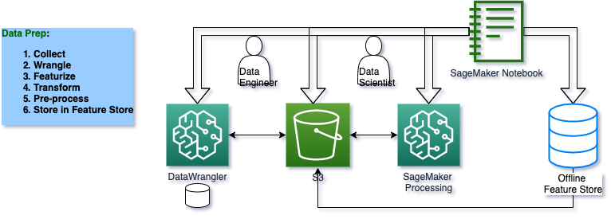
EDA Pipeline

Slide 5
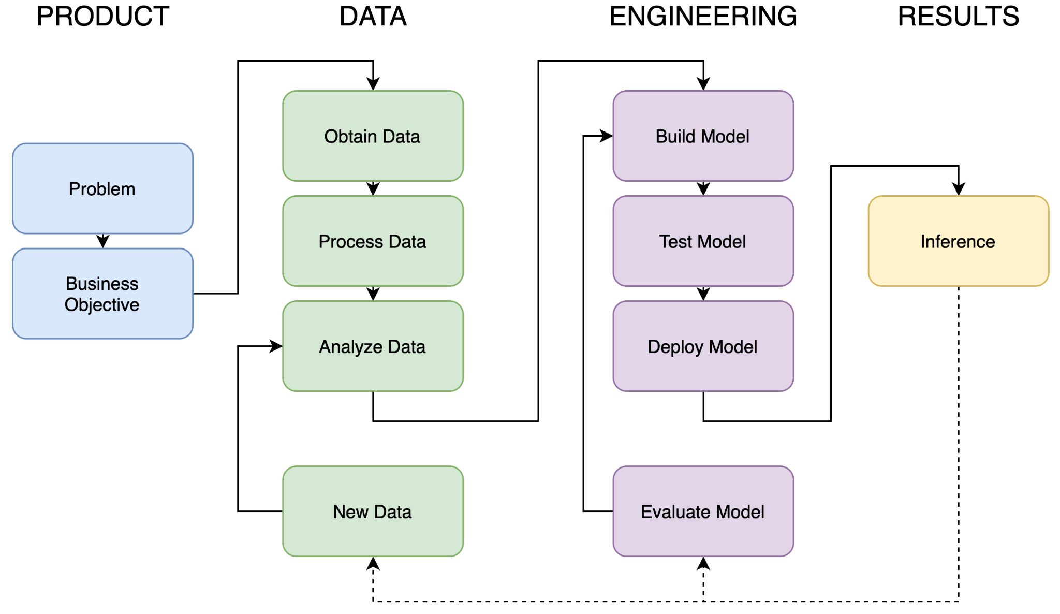
ML Lifecycle

Slide 6
Parameters vs Hyperparameters
They are required by the model when making predictions.
They values define the skill of the model on your problem.
They are estimated or learned from data.
They are often not set manually by the practitioner.
They are often saved as part of the learned model.
Eg: Weights in ANN, Co-effs on ML Algo (Linear regression)
They are often used in processes to help estimate model parameters.
They are often specified by the practitioner.
They can often be set using heuristics.
They are often tuned for a given predictive modeling problem.
Eg: The learning rate for training a neural network.

Slide 7
ML Algorithms
Important article: Bias_variance Tradeoff
Regression - Lasso, Ridge: Regression, Lasso & Ridge
Boosting and Bagging, XGBoost
Tree based Models: Trees, Entropy- IG (Session - 4)

Slide 8



Regression
Cost Function : Ridge Regression:
Ofc, the condition:

Slide 9


Lasso Regression: Condition:

Slide 10
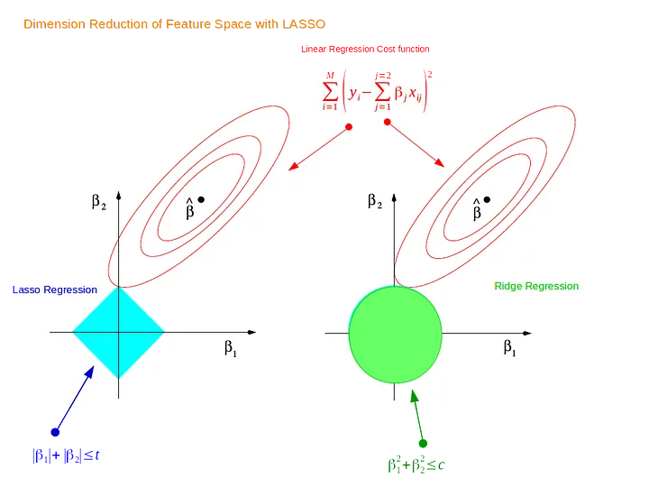
So the impact ?

Slide 11
Bagging | Boosting
Bagging Algorithms
Bootstrap Aggregation or bagging involves taking multiple samples from your training dataset (with replacement) and training a model for each sample.
The final output prediction is averaged across the predictions of all of the sub-models.
Boosting Algorithms
Boosting ensemble algorithms creates a sequence of models that attempt to correct the mistakes of the models before them in the sequence.
Once created, the models make predictions that may be weighted by their demonstrated accuracy and the results are combined to create a final output prediction.

Slide 12
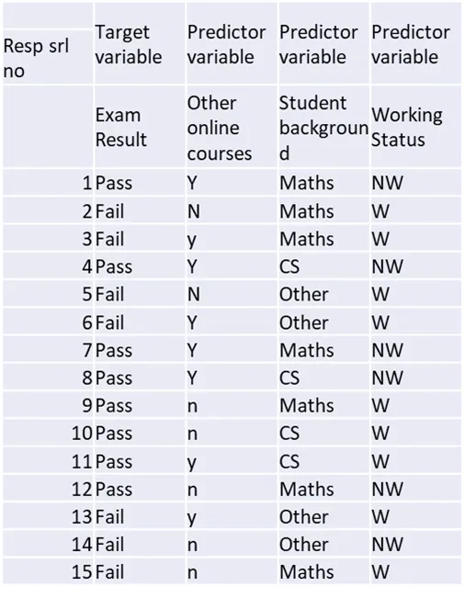
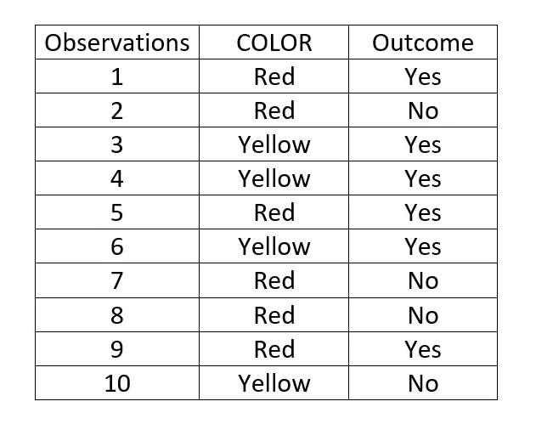
Trees Toy Dataset

Slide 13
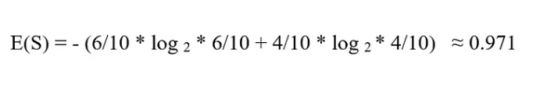
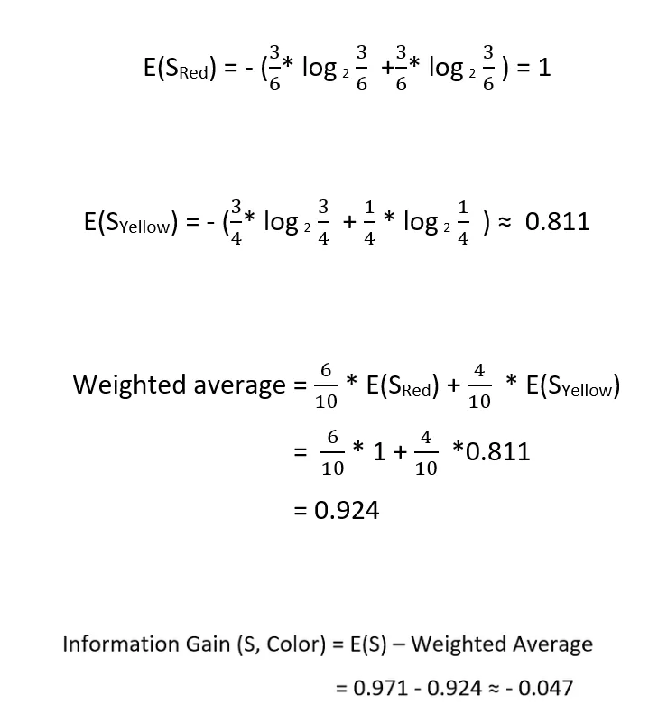

Slide 14
Hints.
Entropy of the output variable.
Entropy of the input feature(s)
Compute the weighted avg/summation.
Get the information gain : 1 - 3
Based on this, decide the node.!

